Slide 1
Cancer Biology Biol 445
Spring 2020
Dr. Heidi Super
Lecture 14
2-26-2020

Slide 2
Quiz 2 returned Friday, if possible. I did take a quick peek at gene tables-–nice job!

Slide 3
Cancer Service projects?
Would you, as a class, like to do something to help cancer patients or to promote awareness or raise money for cancer research?
One small-ish project has popped up. Helping with daffodil days. A yearly fund raiser for the American Cancer Society.
I have other ideas of successful past projects.
Project has to be class-initiated and led—and of course I will help in any way.

Slide 4
Where did we leave off?

Slide 6
RAS is an incredibly important oncogene in human cancers.
https://www.cancer.gov/research/key-initiatives/ras
There are several RAS genes, part of a gene family. NRAS, KRAS, HRAS. Please read paper linked to the website!

Slide 7
Not surprising RAS plays a role in signal transduction. It is a G-protein.
It belongs class of proteins embedded in the cell membrane that are activated soon after a receptor binds on the outside of the cell.
https://en.wikipedia.org/wiki/G_protein

Slide 8
So how can the proto-oncogene like RAS become an oncogene?
What types of alterations would you expect in oncogenes? Recall the general role of oncogenes in the cell cycle?
Mutations in oncogenes are typically gain of function.

Slide 9
Several mechanisms
1. Point mutation:
Most RAS oncogenes in human cancers, have only one nucleotide substitution compared to the normal RAS sequence.
The only difference in the oncogenic Ras protein and the normal Ras protein is a single amino acid change. Figure 9-1

Slide 10
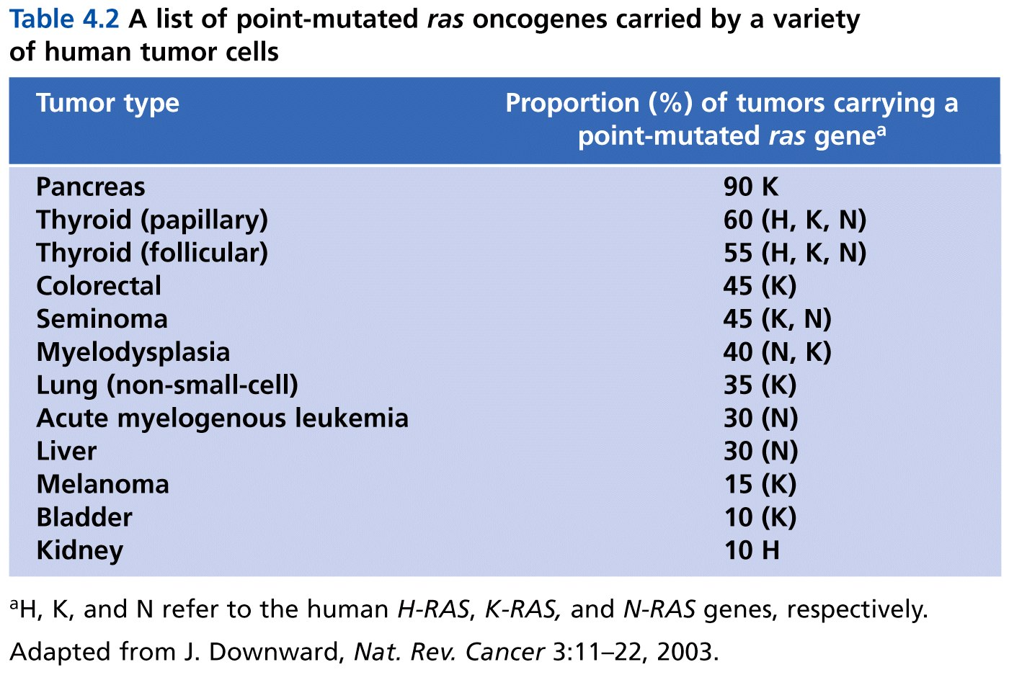
Table 4.2 The Biology of Cancer (© Garland Science 2007)

Slide 11
Some carcinogens (cancer causing mutagens) seem to target specific oncogenes, like RAS with point mutations.
Asbestos
Vinyl chloride
DMBA

Slide 12
Let’s get back on track…
Other oncogenes often show point mutations in specific cancer cells: e.g. RET
One of the rare inherited oncogene mutations. Read about it.

Slide 13
More mechanisms…
2. Gene amplification
Logically, if oncogenes encode proteins that push the cell cycle forward, then extra copies of those genes would tend to accelerate cell division.

Slide 14
How?...
Disrupted replication---repeated copying of a limited region of a chromosome.
creation of HSR in chromosomes.
Creation of double minute chromosomes
Often the repeated region contains a proto-oncogene.
Figure 9-2 and previous lectures.

Slide 15
Both types of chromosome abnormalities are visible with the light microscope and mark some of the major stages in genetic instability of tumor cells.

Slide 16
Specific examples:
MYC
Her2/neu or ERB2
(several cyclins and CDK proteins)
Many others!

Slide 17
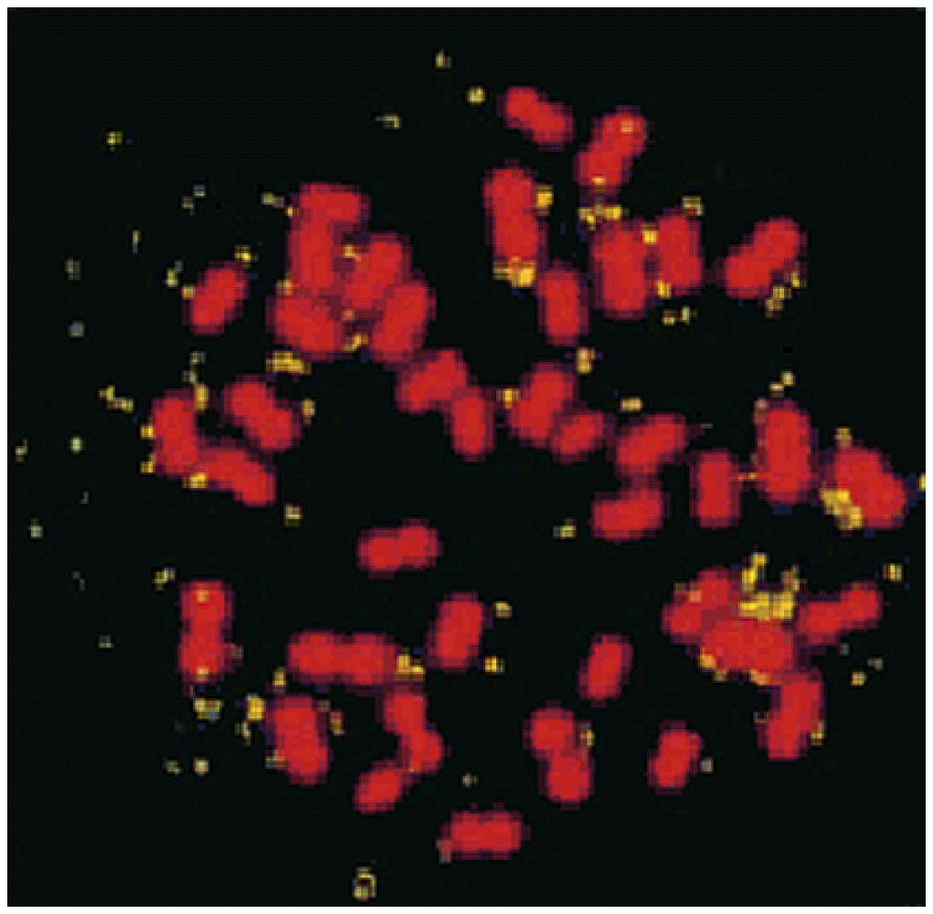
Double minutes stained in yellow show multiple copies of a mouse oncogene, Her2/neu.
The cell was from a mouse mammary cancer.
This gene encodes the epidermal growth factor receptor.
Her2 is the target of Herceptin in human breast cancer treatment!

Slide 18
HSR including the MYC gene in childhood neural cancer (neuroblastoma).
The bright color indicates where a florescent DNA probe forms complementary base pairs with MYC gene sequence.
Technique called fluorescence in situ hybridization or FISH.

Slide 19
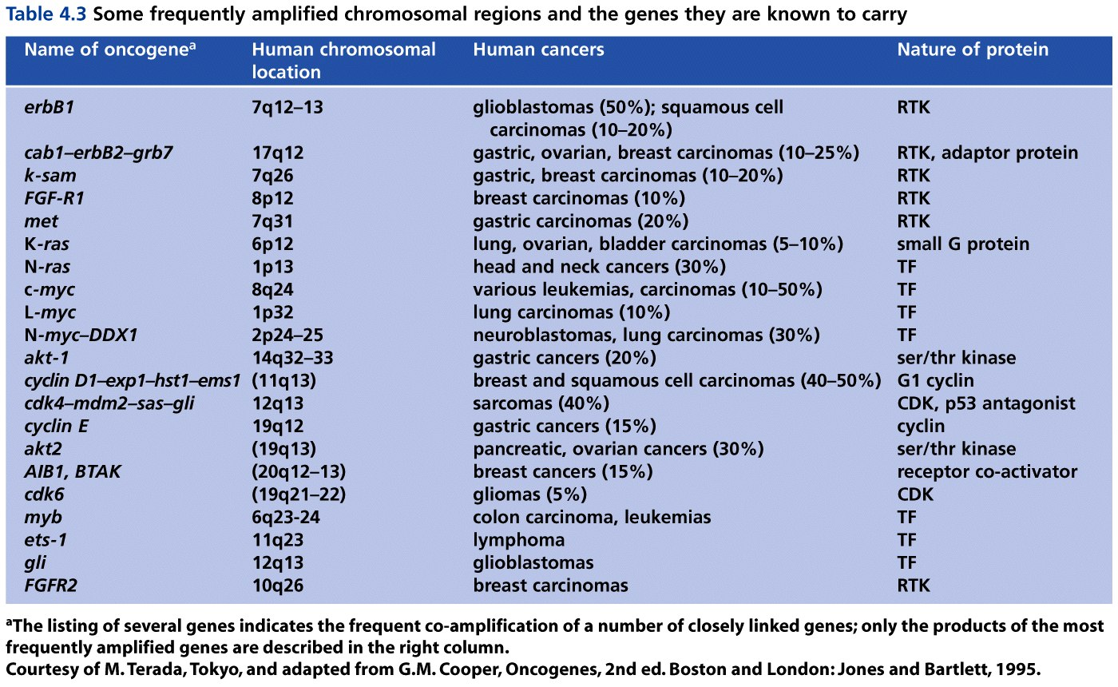
Table 4.3 The Biology of Cancer (© Garland Science 2007)

Slide 20
Measuring oncogene amplification can be used as a diagnostic tool as well as a predictor of the course of a patients disease.
i.e. MYC amplification in neuroblastoma is a predictor for poor outcome. Amplification of Her2/neu is a poor prognostic factor for breast cancer.

Slide 21
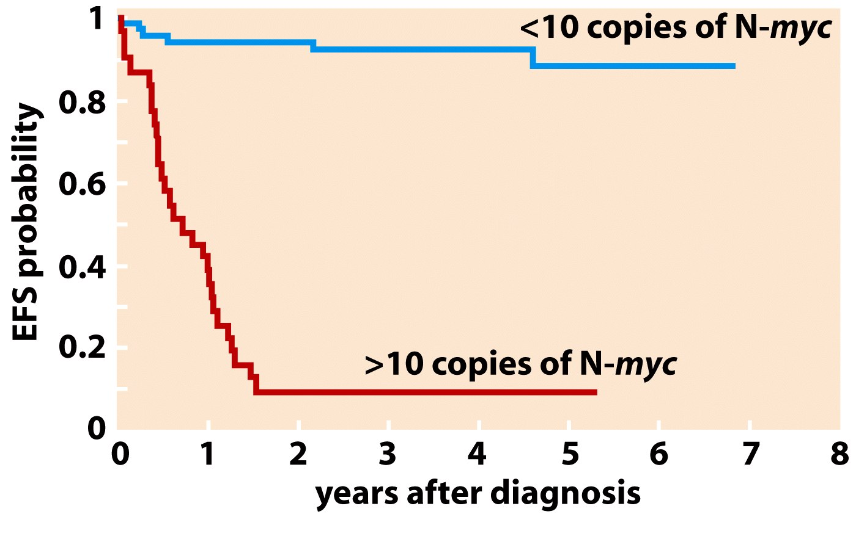
Kaplan-Meier plot for Neuroblastoma study.
Figure 4.11b The Biology of Cancer (© Garland Science 2007)

Slide 22
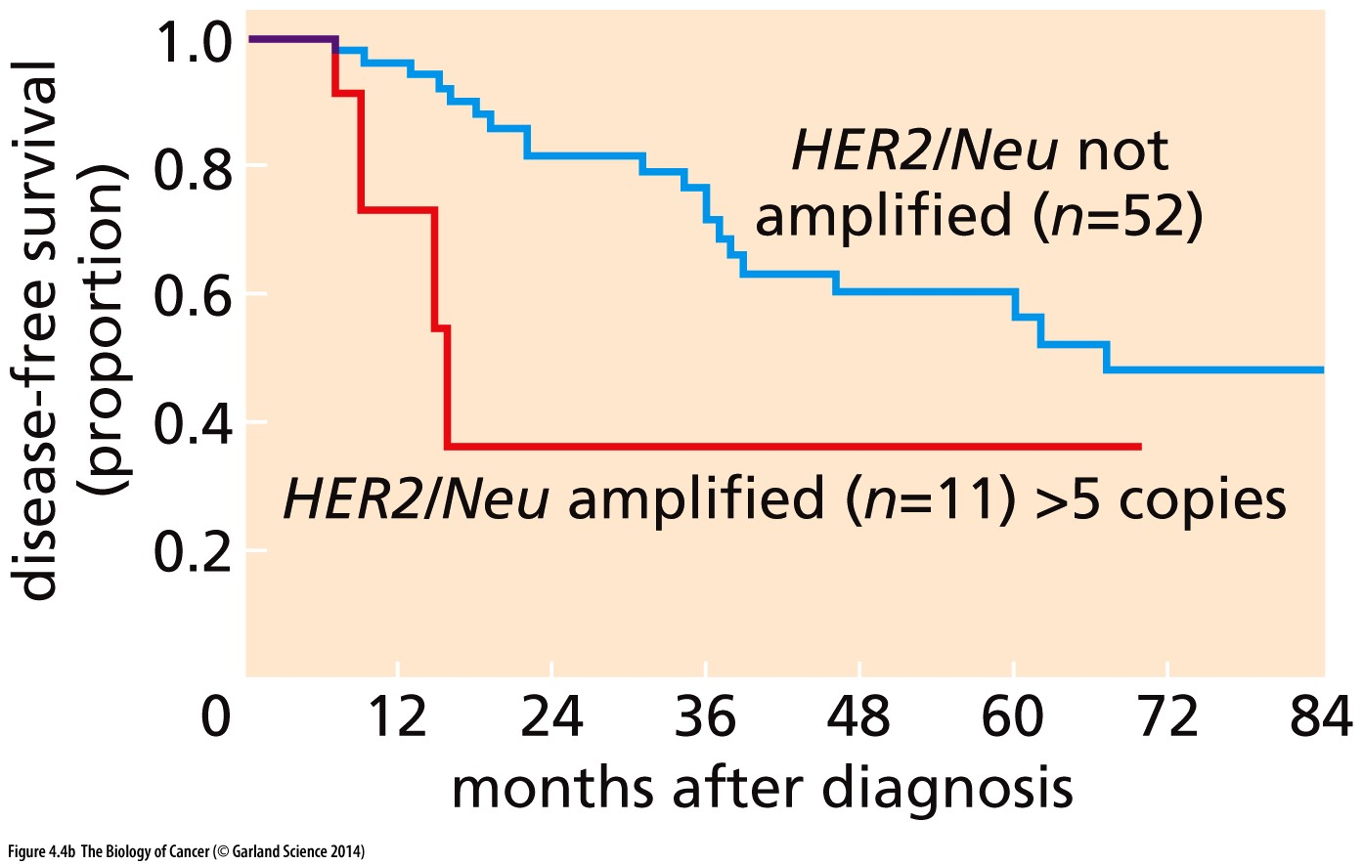
Breast Cancer

Slide 23
3. Chromosome rearrangement
A. Chromosome translocations
Hey we know about this---the Philadelphia Chromosome!
Figure 9-4

Slide 24
Many other examples
In each type of chromosome translocation, a bit of one chromosome breaks and fuses to a non-homologous chromosome.
If no DNA is lost or gained in the process we call these balanced, reciprocal translocations.
It is not uncommon for the junctions of translocations to have missing or duplicated sequence, though.

Slide 25
OK…but how can an oncogene be created via a chromosome translocation?

Slide 26
Non-homologous chromosomes
Gene A
Gene B

Slide 27
Genetic consequences of chromosome translocation
Altered gene expression
Fusion gene formation
Gene A regulatory
Gene B coding
Gene A coding
Gene B coding

Slide 28
Genetic consequences of chromosome translocation
Altered gene expression
Fusion gene formation
Gene A regulatory
IgH promoter/enhancer
Gene B coding
e.g. Myc (proto-oncogene)
Gene A coding
e.g. BCR
Gene B coding
e.g. ABL

Slide 29
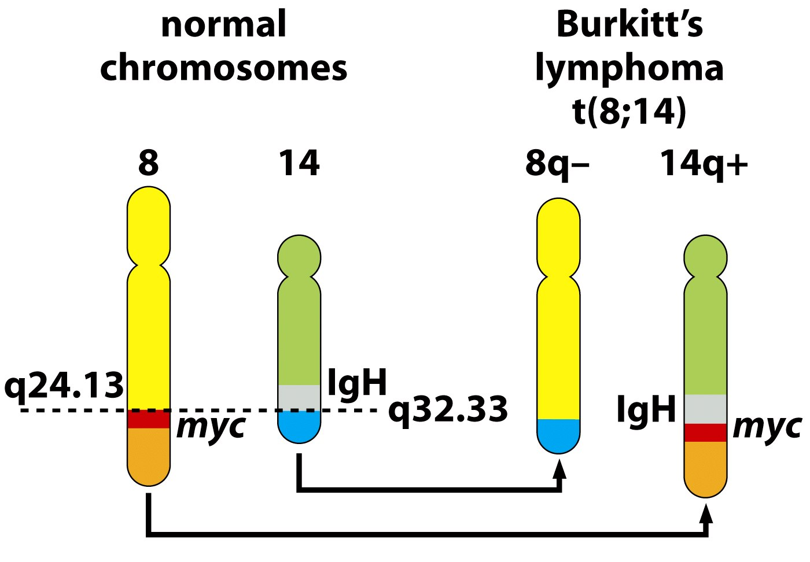
Figure 4.13a The Biology of Cancer (© Garland Science 2007)

Slide 30
The t(8;14) disregulates a proto-oncogene
The t(9;22) Philadelphia chromosome creates a new chimeric/fusion gene which has new oncogenic properties.

Slide 31
Lots of oncogenes have been identified by there location near chromosome translocation breakpoints.
I study one called MLL. MLL fuses to many other genes, but results in acute leukemia regardless of the partner gene.

Slide 32
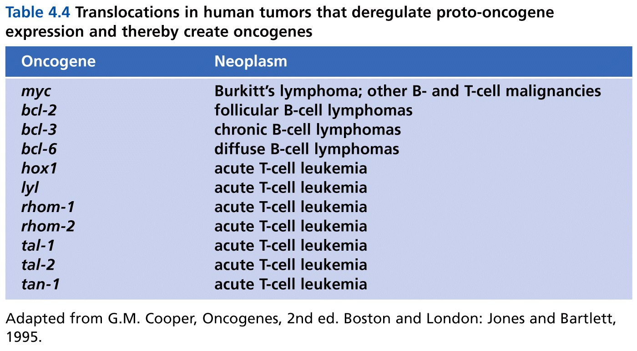
A short list…
Table 4.4 The Biology of Cancer (© Garland Science 2007)

Slide 33
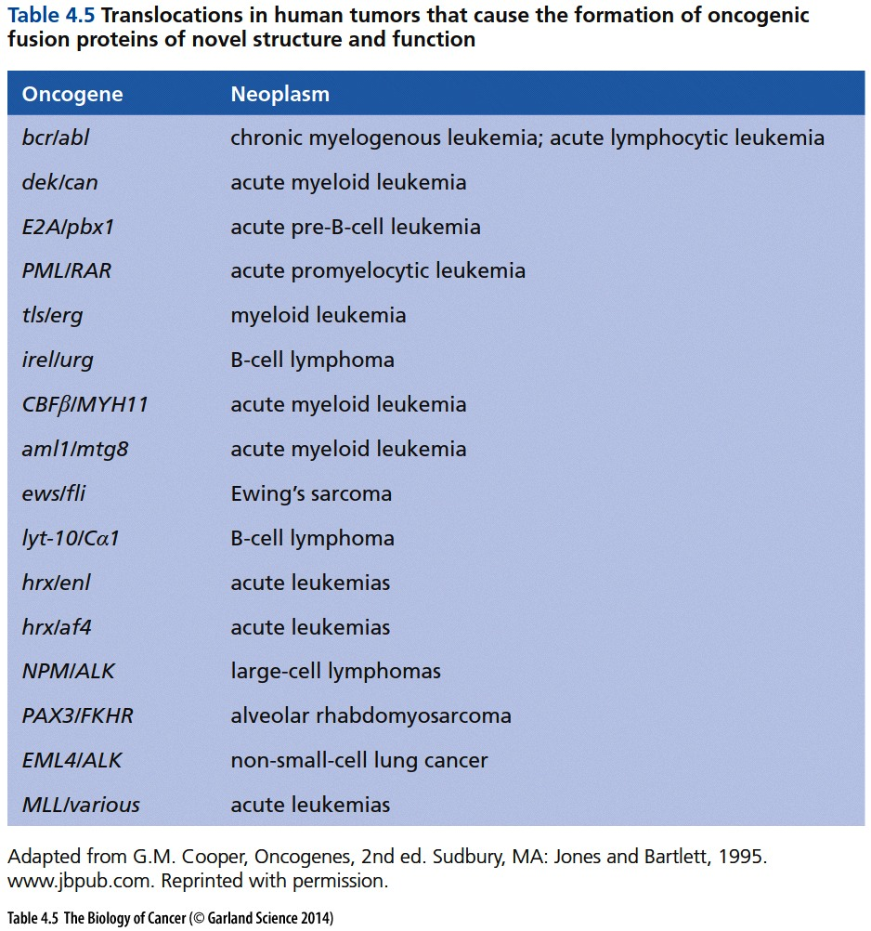

Slide 34
Last mechanism…for turning a proto-oncogene into an oncogene
4. Insertional mutagenesis---
Again, virus-caused cancers are rare in humans but common in some animals. In both non-human animals and humans, viruses can disrupt cellular genes by inserting into the DNA.

Slide 35
We discussed the idea that some retroviruses can cause cancer when they pick up proto-oncogenes from their hosts. Over time the proto-oncogene is mutated to become an oncogene.
In subsequent infections, those gene products make the host cells proliferate abnormally.

Slide 36
Some cancer-causing viruses don’t carry their own oncogenes.
But….they alter the host’s genes by inserting their genome into the host’s DNA, sometimes landing in/near proto-oncogenes in the host DNA.

Slide 37
The proximity to the cellular proto-oncogene can cause it to be up-regulated.
Ca
Mechanism for gain of function mutation

Slide 38
Examples
Avian Leukosis virus carries no oncogenes, but inserts into the MYC gene, causing increased expression of MYC in white blood cells in birds.
Murine (mouse) leukemia viruses—insert into various genes resulting in leukemia.

Slide 39
Both examples of retroviruses:
After insertion, they are very efficient at initiating gene expression (transcription) (attracting RNA polymerase).
The effect spills over to nearby DNA regions of DNA causing nearby genes to be transcribed like crazy.

Slide 40
Retroviruses are often used in research to get a new gene into an organism’s genome.
Sometimes the goal is to create/locate oncogenes or induce abnormal gene expression related to cancer (Jake)
Sometimes the goal is different (not to create disease to find genes associated with the disease.)
Development of transgenic organisms
Development of gene therapy approaches

Slide 41
But sometimes the cancer-causing effect of insertion of foreign DNA has complicated these experiements.
Inadvertent /unintended insertion of a transgene into/near an oncogene results in cancer in an experimental animal.
Gene therapy i.e. for immune deficiencies, increases the patients risk for cancer. (by insertion of therapeutic gene near oncogenes).

